Slide 1
Gross Domestic Product by County Statistics: A Project Update
BEA Advisory Committee Meeting
November 9, 2018

Slide 2
Outline
Status update
Release of prototype statistics
First look at results

Slide 3
Status Update
ü
Identify data sources
ü
Process available data sources
Acquire and process new data sources
ü
Develop methodology
ü
Develop estimation software
Review and release prototype statistics
Evaluate and refine methodology
Apply suppressions
Determine publishable detail
Review statistics for official release

Slide 4
Release of GDP by County (Prototype Estimates)
Release date: December 12, 2018
Data series: Annual current- and inflation-adjusted GDP statistics for all counties (3,113)
Industry detail:
  All industry total
    Private goods-producing industries
    Private services-producing industries
    Government
Period: 2012-2015
Data user feedback: gdpbycounty@bea.gov

Slide 5
Industry Detail
All industry total
 | Private goods-producing industries
 |  | Agriculture, forestry, fishing, and hunting
 |  | Mining
 |  | Construction
 |  | Manufacturing
 | Private services-producing industries
 |  | Utilities
 |  | Wholesale trade
 |  | Retail trade
 |  | Transportation and warehousing
 |  | Information
 |  | Finance and insurance
 |  | Real estate and rental and leasing
 |  | Professional, scientific, and technical services
 |  | Management of companies
 |  | Administrative and support and waste management and remediation services
 |  | Education services
 |  | Health care and social assistance
 |  | Arts, entertainment, and recreation
 |  | Accommodation and food services
 |  | Other services (except government and government enterprises)
 | Government
 |  | Federal civilian
 |  | Military
 |  | State and local

Slide 6
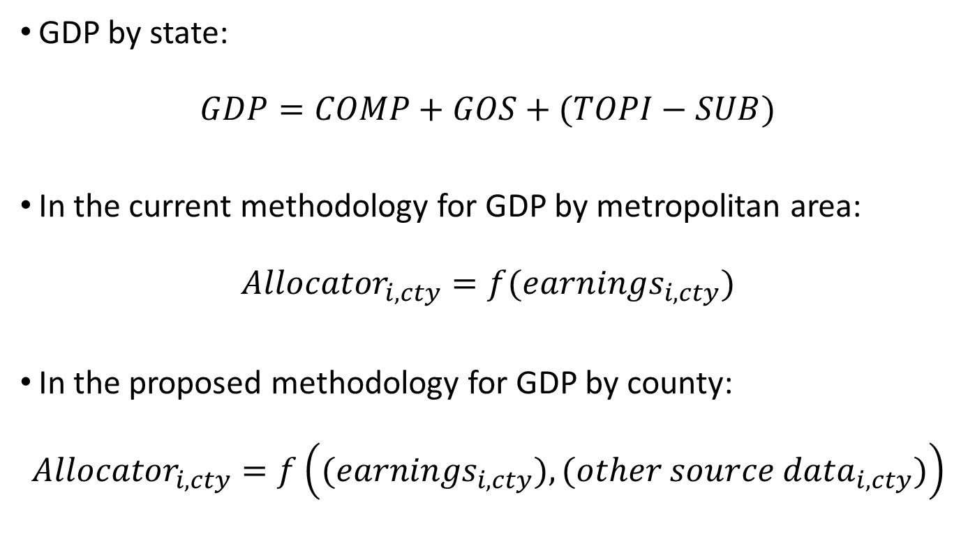
General Methodology
GDP by state:
$$GDP=COMP+GOS+(TOPI−SUB)$$
In the current methodology for GDP by metropolitan area:
$${Allocator}_{i,cty}=f({earnings}_{i,cty})$$
In the proposed methodology for GDP by county:
$${Allocator}_{i,cty}=f\left({(earnings}_{i,cty}),({other source data}_{i,cty})\right)$$

Slide 7
Source Data
GDP by state
County earnings by industry
  Quarterly Census of Employment and Wages (QCEW)
  Statistics of Income (SOI)
Economic Census
National Establishment Time-Series (NETS) Database
Farm: U.S. Department of Agriculture (USDA)
Banking: Federal Deposit Insurance Corporation (FDIC)
Utilities: Energy Information Administration (EIA)

Slide 8
Corroboration Sources
NETS database
IncentivesMonitor.com Database
The State Business Incentives Database
The State Development Program Expenditures Database
Conway Data’s New Plant Database
Mining: Energy Information Administration (EIA), Drilling Edge

Slide 9
Key Improvements
More accurate geographic allocation of industry output, particularly for capital intensive industries
More accurate identification of economic turning points
Lower suppression rates

Slide 10
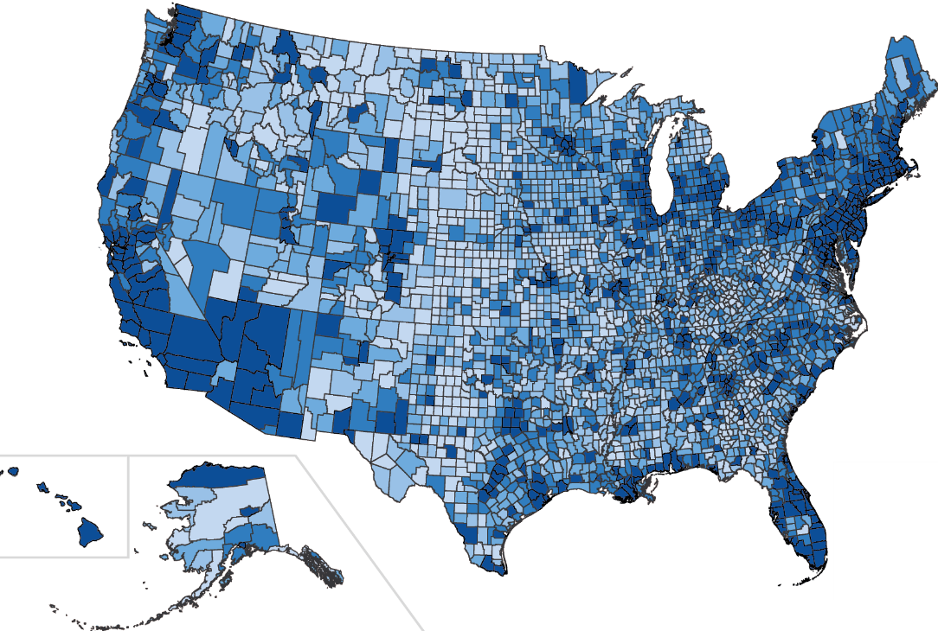
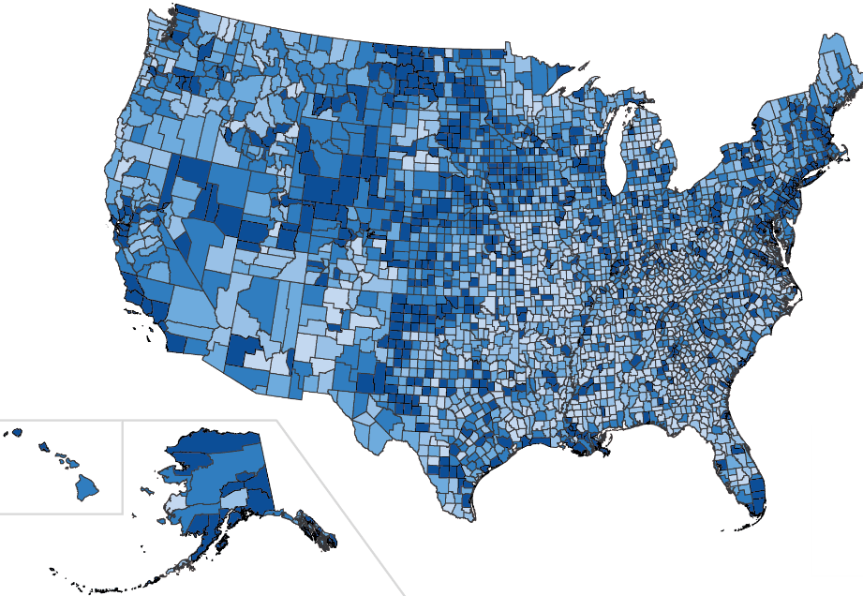
GDP by County, Current Dollars, 2015
Total GDP
Per Capita Total GDP

Slide 11
South Dakota Counties, 2015
Minnehaha
Brown
Pennington
Lincoln
Brookings
Brown
Lincoln
Pennington
Brookings

Slide 12
Vermont Counties, 2015
Accommodations and Food Services
Chittenden
Windham
Franklin
Washington
Windsor
Utilities
Chittenden
Windham
Franklin
Washington
Windsor

Slide 13
Vermont Counties, Utilities
2013
Windham
Rutland
Chittenden
Franklin
Windsor
Chittenden
Rutland
Windham
Franklin
Windsor

Slide 14
Windham, VT: Utilities
EIA Electricity Generation
Industry Earnings

Slide 15
Vermont Counties, Utilities
2013
Windham
Rutland
Chittenden
Franklin
Windsor
Chittenden
Rutland
Windham
Franklin
Windsor

Slide 16
Rutland, VT: Utilities
EIA Electricity Generation
Industry Earnings

Slide 17
Rutland, VT: Utilities

Slide 18
Next Steps
Develop further improvements and refinements to the prototype statistics
  Construction: Dodge Data and Analytics
  Transportation: Bureau of Transportation Statistics (BTS)
  Mining: Energy Information Administration (EIA), Drilling Edge
  County Business Patterns
  LEHD Quarterly Workforce Indicators (QWI)
Analyze suppression patterns and determine the level of industry detail for official release
Continue to solicit and incorporate data user feedback
Official release on December 12, 2019

